Slide 1
CLUSTER ANALYSIS
Introduction to Clustering
Major Clustering Methods

Slide 2
Introduction to Clustering
Definition
The process of grouping a set of physical or abstract objects into classes of similar objects

Slide 3
Introduction to Clustering
Advantages
Adversely to classification which requires the often costly collection and labeling of a large set of training
tuples or patterns, it proceeds in a reverse direction:
* Partition the set of data into groups based on data similarity
* Assign labels to the relatively small number of groups

Slide 4
Introduction to Clustering
Importance & Necessity
Discover overall distribution patterns and interesting correlations among data attributes.
* Used widely in numerous applications: market research, pattern recognition, data analysis, and image processing
* Used for outlier detection such as detection of credit card fraud or monitoring of criminal activities in electronic commerce
* In business: characterize customer groups based on purchasing patterns
* In biology: used to derive plants and animal taxonomies, categorize genes with similar functionality

Slide 5
Introduction to Clustering
Pseudonym
Occasionally called data segmentation because clustering partitions large data sets into groups according to their similarity

Slide 6
Introduction to Clustering
Statistical Application
Based on k-means, k-medoids, and several other methods, Cluster analysis tools have also been built into many statistical analysis software packages or systems, such as S-Plus, SPSS, and SAS
Clustering is a form of learning by observation (unsupervised learning) whereas learning machine is a form of learning by examples

Slide 7
Major Clustering Methods
Partitioning methods
Hierarchical methods
Density-based methods
Grid-based methods
Model-based methods
Clustering high-dimensional data
Constraint-based clustering

Slide 8
Partitioning Methods
Abstract
Taxonomy

Slide 9
Abstract
Premise
Given a database of n objects or data tuples, a partitioning method constructs k partitions of the data, where each partition represents a cluster and k <= n. That is, it classifies the data into k groups, which together satisfy the following requirements: (1) each group must contain at least one object, and (2) each object must belong to exactly one group.

Slide 10
Abstract
General Criterion
Objects in the same cluster are “close” or related to each other, whereas objects of different clusters are “far apart” or very different

Slide 11
Taxonomy
Centroid-Based Technique: k-means paradigm
Representative Object-Based Technique: The k-Medoids Method

Slide 12
K-MEANS PARADIGM
Basic K-Means Algorithm
Bisecting K-Means Algorithm
EM (Expectation-Maximization) Algorithm
K-Means Estimation: Strength and Weakness

Slide 13
K-Means Clustering
(Centroid-Based Technique)
I. The Algorithm
Define k centroids, one for each cluster.
These centroids should be place in a cunning way.
Take each point belonging to a given data set and associate it to the nearest centroid.
Re-calculate k new centroids. A loop has been generated ultil no more changes are done.

Slide 14

K-Means Clustering
(Centroid-Based Technique)
I. The Algorithm
Typically, the square-error criterion is used, defined as
where E is the sum of the square error for all objects in the data set, p is the point in space representing a given object, and m_{i} is the mean of cluster C_{i.}

Slide 15
K-Means Clustering
(Centroid-Based Technique)
I. The Algorithm
The algorithm is composed of the following steps:
Place K points into the space represented by the objects that are being clustered. These points represent initial group centroids.
Assign each object to the group that has the closest centroid.

Slide 16
K-Means Clustering
(Centroid-Based Technique)
I. The Algorithm
3. When all objects have been assigned, recalculate the positions of the K centroids.
4. Repeat steps 2 and 3 until the centroids no longer move.

Slide 17
K-Means Clustering
(Centroid-Based Technique)
I. The Algorithm
This is a greedy algorithm, it doesn’t necessarily find the most optimal configuration, corresponding to the global objective function minimum.
The algorithm is also significantly sensitive to the initial randomly cluster centres.

Slide 18
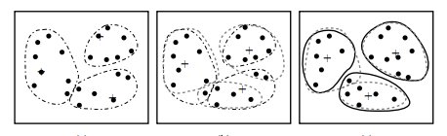
K-Means Clustering
(Centroid-Based Technique)
II. Example

Slide 19
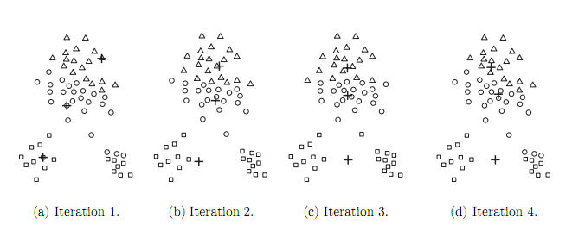
Representative Object-Based Technique:
The K-Medoids Method
The k-means algorithm is sensitive to outliers because an object with an extremely large value may substantially distort the distribution of data.

Slide 20
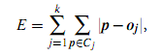
Representative Object-Based Technique:
The K-Medoids Method
Approach:
Instead of taking the mean value of the objects in a cluster as a reference point, we can pick actual objects to represent the clusters, using one representative object per cluster.
Each remaining object is clustered with the representative object to which it is the most similar.
An absolute-error criterion is used:

Slide 21
Hierarchical Methods:
Bisecting K-Means
Approach:
The bisecting K-means algorithm is a straightforward extension of the basic K-Means algorithm that is based on the simple idea: to obtain K cluster, split the set of all points into two clusters, select one of these clusters to split, and so on, until K clusters have been produced.

Slide 22
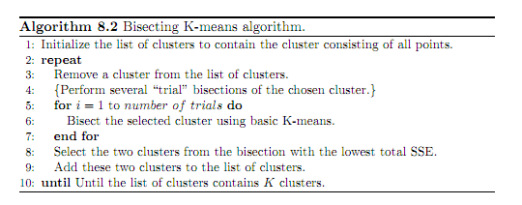
Hierarchical Methods:
Bisecting K-Means
Bisecting K-Means Algorithm

Slide 23
Hierarchical Methods:
Bisecting K-Means
Different ways to choose which cluster to split:
Choose the largest cluster at each step, or
Choose the one with the largest SSE, or
Use a criterion based on both size and SSE.
Different choices result in different clusters.
Advantage:
Bisecting K-Means is less susceptible to initialization problems

Slide 24
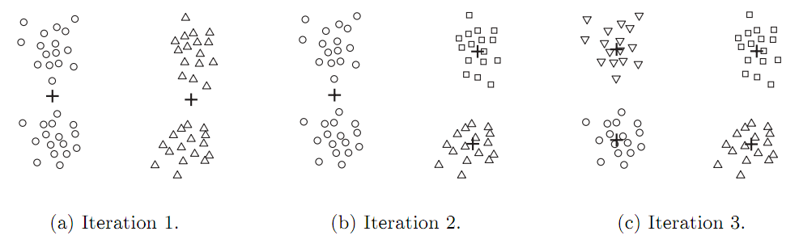
Hierarchical Methods:
Bisecting K-Means
Example:
Bisecting K-Means on the four clusters example.

Slide 25
Model-Based Clustering Methods:
Expectation-Maximization
Approach:
Each cluster can be represented mathematically by a parametric probability distribution.
Cluster the data using a ﬁnite mixture density model of k probability distributions , where each distribution represents a cluster.
The problem is to estimate the parameters of the probability distributions so as to best ﬁt the data ?

Slide 26
Model-Based Clustering Methods:
Expectation-Maximization
Instead of assigning each object to a dedicated cluster, EM assigns each object to a cluster according to a weight representing the probability of membership.
new means are computed based on weighted measures.
EM Algorithm
Make an initial guess of the parameter vector: randomly selecting k objects to represent the cluster means.
Iteratively reﬁne the parameters (or clusters) based on the following two steps:

Slide 27
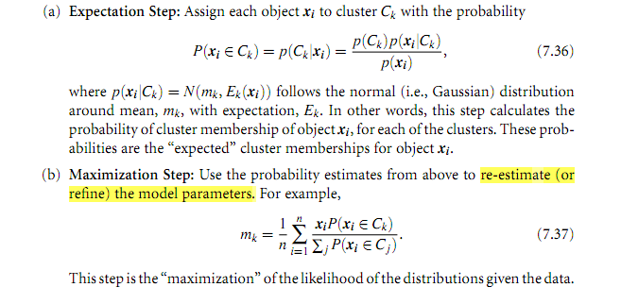
Model-Based Clustering Methods:
Expectation-Maximization

Slide 28
K-Means Estimation: Strength and Weakness
Strength:
K-Means is simple and can be used for a wide variety of data types and,
Efficient even through multiple runs are often performed.
Some variants, including K-Medoids, bisecting K-Means, EM are more efficient and less susceptible to initialization problems.
Weakness:
Cannot handle non-globular clusters or cluster of different sizes and densities.

Slide 29
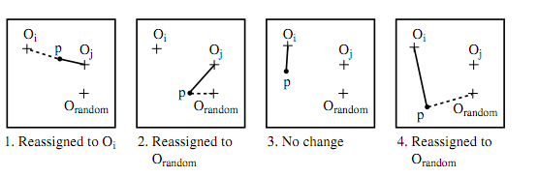
Representative Object-Based Technique:
The K-Medoids Method
To determine whether a non-representative object, o_{random}, is a good replacement for a current representative object, o_{j}, the following four cases are examined for each of the non-representative objects, p

Slide 30
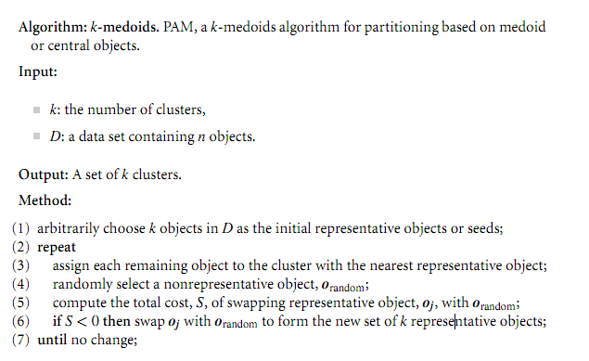
Representative Object-Based Technique:
The K-Medoids Method
PAM(Partitioning AroundMedoids) was one of the ﬁrst k-medoids algorithms introduced

Slide 31
Representative Object-Based Technique:
The K-Medoids Method
The complexity of each iteration is O(k(n-k)²).
The k-medoids method is more robust than k-means in the presence of noise and outliers, because a medoid is less inﬂuenced by outliers or other extreme values than a mean.
However, its processing is more costly than the k-means method with complexity O(nkt).

Slide 32
References
Data mining concepts and techniques 2nd: Jiawei Han and Micheline Kamber
Introduction to Data Mining: Pang-Ning Tan - Michigan State University, Michael Steinbach - University of Minnesota , Vipin Kumar - University of Minnesota .
Machine Learning for Data Mining - Week 6 – Clustering: Christof Monz - Queen Mary, University of London.
http://en.wikipedia.org/wiki/K-medoids

